Slide 1

Arab Uprisings: Saudi Arabia
By Dr. Rayan Mohammad

Slide 2
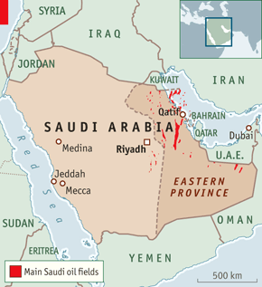
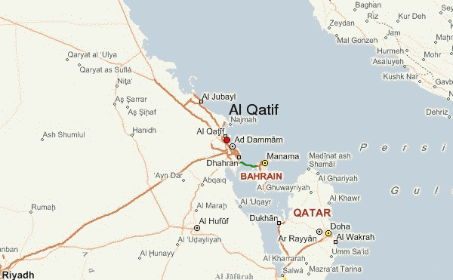
Saudi Arabia Is Located In Southwestern Asia

Slide 3
Saudi Arabia Population
Population: 27,345,986

Slide 4
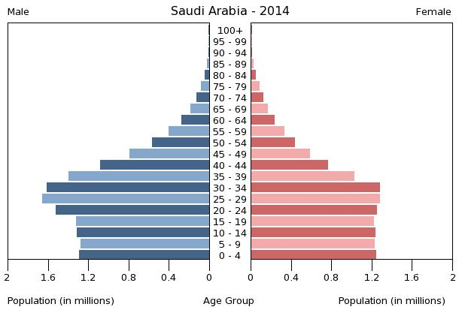
Age Pyramid: age structure
0-14 years: 27.6% (male 3,869,961/female 3,681,616)
15-24 years: 19.3% (male 2,832,538/female 2,458,339)
25-54 years: 45.4% (male 7,086,004/female 5,323,373)
55-64 years: 4.5% (male 674,571/female 555,136)
65 years and over: 3.1% (male 444,302/female 420,146) (2014 est.)
Median Age
total: 26.4 years
male: 27.3 years
female: 25.3 years (2014 est.)

Slide 5
By Rayan Mohammad

